Slide 1
The Perspective of CDMOs in the Future of Pharmaceutical Industry
Andrea Paci
Professor of Management
Barcelona, 4th October 2016

Slide 2
The European Undervaluation of Italy and the South Countries in Europe
Since the global financial crisis in 2008, Italy has always been considered one of the weak point of Europe, together with other south countries (PIGS).
Low growth rate of GDP
Large Public Debt
High Unemployment
Complex burocracy and Public Administration
High tax pressure

Slide 3
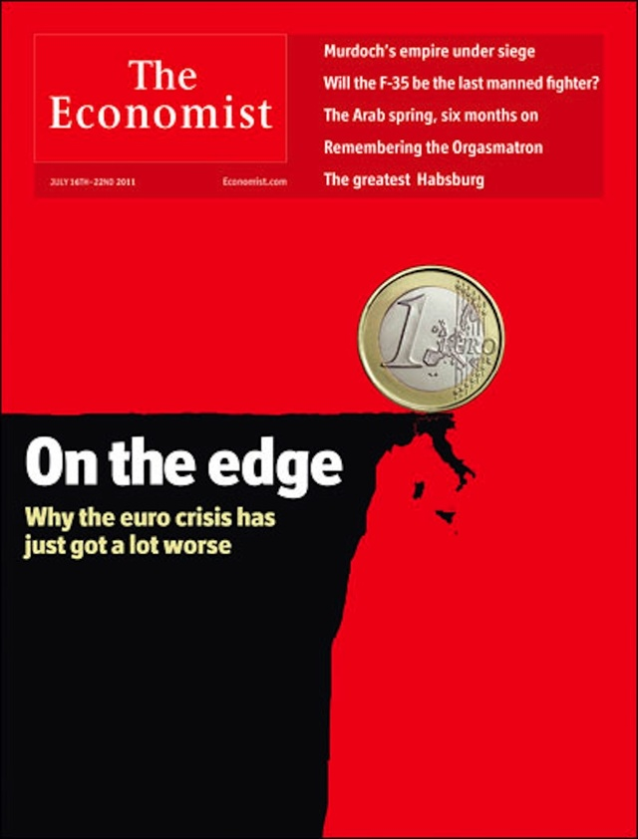
The narrative of a misunderstanding
Source: The Economist

Slide 4
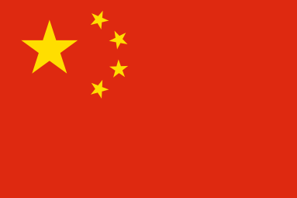
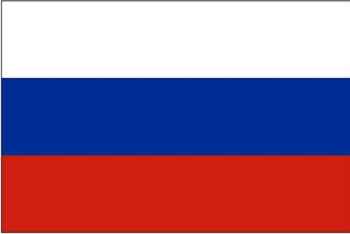
Un Unconventional Truth
The Top Five Players in Manufacturing Trade Balance in 2015 (€B)
1st
+738
In recent years Italy performed very well in the manufacturing market, achieving the fifth manufacturing trade surplus amongst G-20 countries, surpassed only by Germany amongst European countries.
2nd
+269
3rd
+106
4th
+103
5th
+57
Source: Italian Trade Agency, IHS Markit - GTA

Slide 5
World’s Export Shares of Manufactured Products (2014 vs 2010)
Source: WTO, Italian Trade Agency, IHS Markit - GTA

Slide 6
Giving a Look at the Pharma Industry in Italy
1st among all manufacturing sector for investment and export of foreign-owned companies
30€ billion the value of production (73% for export - 22€ billion)
2.6€ billion total amount of investments (1.4€B R&D and 1.2€B production)
70% the share of export on total turnover of italian-owned companies
63.500 employees (90% have an academic degree or high school diploma)
6.100 researchers (52% are women)
+15% R&D investments since 2013
200 members companies of Farmindustria, that represent more than 90% of the sector in Italy
Source: Farmindustria, Istat, Ocse

Slide 7
The CDMO Market in the European Union
With a 5.1$B CDMO’s product value in European Union, Italy is the first producer country (1.5$B) followed by Germany (1.2$B) and France (1.0$B), despite tax pressure is 1.5 times higher
Leadership and High Specialization CDMO market share (29%) exceeds EU28 manufacturing market share (13%)
High Qualified Employment
8.000 employees in Italy, compared to 6.000 in Germany and 5.000 in France
Source: Prometeia

Slide 8
5 Years of the Italian CDMO’s Market (2010 - 15)
Production value : +24%
Export value : +34%
+89%
+153%
+304%
-15%
+19%
+9%
+9%
Source: Prometeia

Slide 9
Which game for CDMOs
 |  | Emerging/specialized technology | Core/foundational technology | Mature technology
 | Propensity to outsource | High | Low | High
Strategic Driver | Knowledge
 | Networks
Innovation Driven CDMOs
Focused on higher-value market opportunities, including new molecular entities and improved dose forms and formulations of older drugs
Capacity Driven CDMOs
Focused on filling largely undifferentiated manufacturing capacity primarily by producing generics, undifferentiated over-the-counter (OTC) medications, and late lifecycle branded products

Slide 10
What typically gets outsourced?
 | Emerging/specialized technology | Core/foundational technology | Mature technology
Characteristics | Occasional need Expensive to build/hold High risk Unproven | Central to strategy Performance evolving rapidly High utilization Knowledge-generating | Declining strategic importance Evolution slowing Established procedures Widely-available
Examples | Highly potent API Gene/cell therapy Specialty drug delivery | Mammalian cell culture Injectable fill/finish Methods & form development | Small/molecule API Solid dose Testing with validated methods
Propensity to outsource | High | Low | High

Slide 11
The times they are changing – A new Revolution in Industry

Slide 12
The times they are changing – Top Ten Corporation (Market Capitalization - $ B)
2006 ($2,850 B)
2016
($3,623 B)
Oil&Gas
$447 B
IT Company
$508 B
Conglomerate
$384 B
IT Company
$498 B
IT Company
$294 B
IT Company
$396 B
Banking
$273 B
Oil&Gas
$367 B
Oil&Gas
$271 B
Conglomerate
$354 B
Banking
$254 B
INTERNET $294 B
IT Company
$342 B
INTERNET $2.062 B
Auto
$241 B
IT Company
$318 B
Banking
$240 B
Health Care
$311 B
Oil&Gas
$226 B
Conglomerate
$280 B
Oil&Gas
$218 B
Banking
$249 B

Slide 13
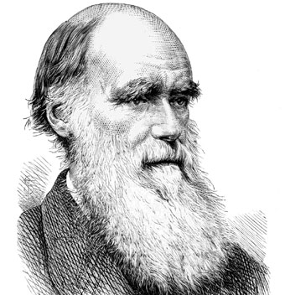
The lesson of Charles Darwin
“It is not the strongest species that survive, nor the most intelligent, but the ones most responsive to change”
Etched into the floor at the California Academy of Science

Slide 14
The forth industrial revolution and quick convergence of different industry
“We have reached a critical moment, a point where the digital agenda is fusing with industrial production”
Angela Merkel said in April 2016 at the Hanover Messe, the world’s largest industrial fair.
“Nokia didn’t take the challenge posed by Apple and its iPhone seriously and within a few years, it found itself on the brink of collapse and was broken up.
The fear in Germany is that the auto industry is about to reach a similar tipping point as digital advances lower the barriers to entry into the car industry.
While a Google or Apple self-driving car may have been unthinkable just a few years ago, it could soon become reality”.
Source: Karnitschnig 2016, Why Europe’s largest economy resists new industrial revolution in www.politico.eu

Slide 15
The Fourth Revolution of Industry and New Scenarios
Source: Germany Trade & Invest, Industry 4.0

Slide 16
Why Italy will go on being one of the top manufacturing countries?
Many Italian companies create value through specialization, and Industry 4.0 model, gives a main role to big data and analytics;
Real Time Replenishment: supply chain’s automatic management, with no stop monitoring of warehouses for increase lead times
Facilities‘ Remote Control: automated management of the operation and maintenance of production facilities
Virtual Factory: simulation and verification of feasibility of alternative production scenarios

Slide 17
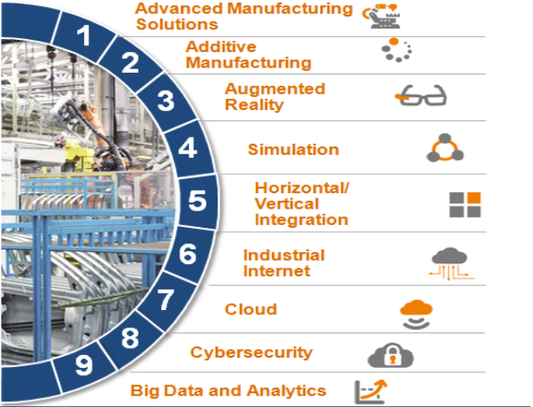
What is the Italian Governament Doing?
According to ‘Piano nazionale Industria 4.0’, introduced by italian Prime Minister Matteo Renzi and Minister of Economic Development Carlo Calenda (September, 2016), in the next 4 years there will be 23 billion of euro of public investments, in order to improve times for the fourth industrial revolution.
New rules for “depreciation” will be included as concessions for improve private investments. Credit taxes for research will be raise to 500,000€ from previous 300,000€, while fiscal detraction will be 30% with a maximum of 1€M (from 19% with a maximum of 0.5€M).

Slide 18
The Future of CDMOs
According to government promises and experts analysis, the future of italian CDMOs looks bright.
More than 80% of experts expect a global growth in production by 2020, and for the 44% of them it will be more than 5% for year.
According to Bain & Company, global production will grow more than 10% for year.
According to President of Farmindustria Massimo Scaccabarozzi, the obstacle to overcome ask for the creation of new and clearer administrative rules which could improve the CDMOs business, enabling better performance and more competitive advantages.

Slide 19
The Big Pharma in Search of a New Business Model – New Opportunities for CDMOs
“The old blockbuster model can’t be the centerpiece of big pharma’s strategy going forward.
The old model is dead, and big pharma is struggling to come to terms with what new model is going to work.
What is clear is that scale is not going to do it.”
J. Kimberly, management professor, Wharton - University of Pensilvenya
”The age of the blockbuster also reflected a “one-size-fits-all” approach to drugs.
The drug industry has been moving away from that, toward more of a personalized approach”
J. Loo, health care equity analyst for S&P Capital IQ

Slide 20
New Business Model at the time of Industry 4.0
“German companies generally consider their work to be done once a product leaves the factory.
But in the world of Industry 4.0, also called the industrial internet, that’s just the beginning.
A matrix of internet-enabled sensors will soon link factories with customers and suppliers to optimize production and service.”.
Source: Karnitschnig 2016, Why Europe’s largest economy resists new industrial revolution in www.politico.eu

Slide 21
Michel Porter’s Generic Strategies Framework Revised
STRATEGIC ADVANTAGE
Uniqueness Perceived by the Customer
Low-Cost Position
Innovation Driven CDMOs
Focused on higher-value market opportunities - including new molecular entities and improved dose forms and formulations of older drugs
Large Scale Advantage
(Blockbuster model)
Knowledge
STRATEGIC
DRIVER
Customer Care
(Industry 4.0)
Capacity Driven CDMOs
Focused on filling largely undifferentiated manufacturing capacity primarily by producing generics, undifferentiated over-the-counter (OTC) medications, and late lifecycle branded products
Networks

Slide 22
The lesson of Marco Polo (by Italo Calvino)
Marco Polo describes a bridge, stone by stone.
"But which is the stone that supports the bridge?"
Kublai Khan asks.
"The bridge is not supported by one stone or another,"
Marco answers, "but by the line of the arch that they
form. "
Kublai Khan remains silent, reflecting. Then he adds:
"Why do you speak to me of the stones? It is only the arch
that matters to me."
Polo answers: "Without stones there is no arch."
Italo Calvino 1972, Invisible Cities

